Slide 1
Lesson: Me And My Bedroom

Slide 2
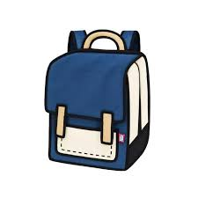
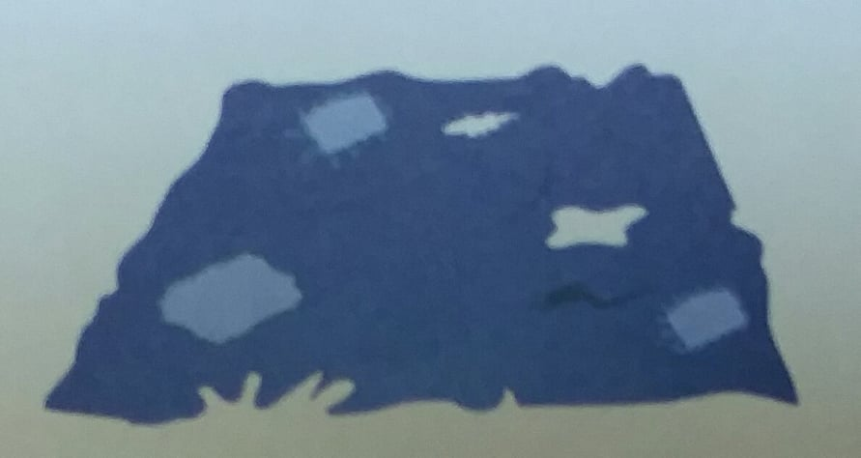
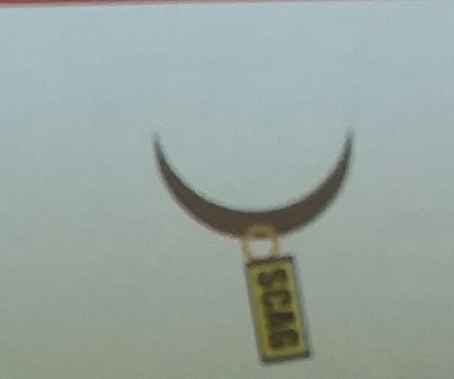
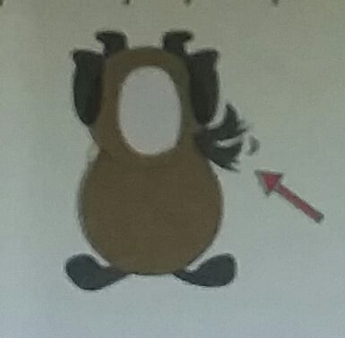
Learn the sound/ learn new words
/b/ /ag/
bag
/r/ /ag/
rag
/t/ /ag/
tag
/w/ /ag/
wag

Slide 3
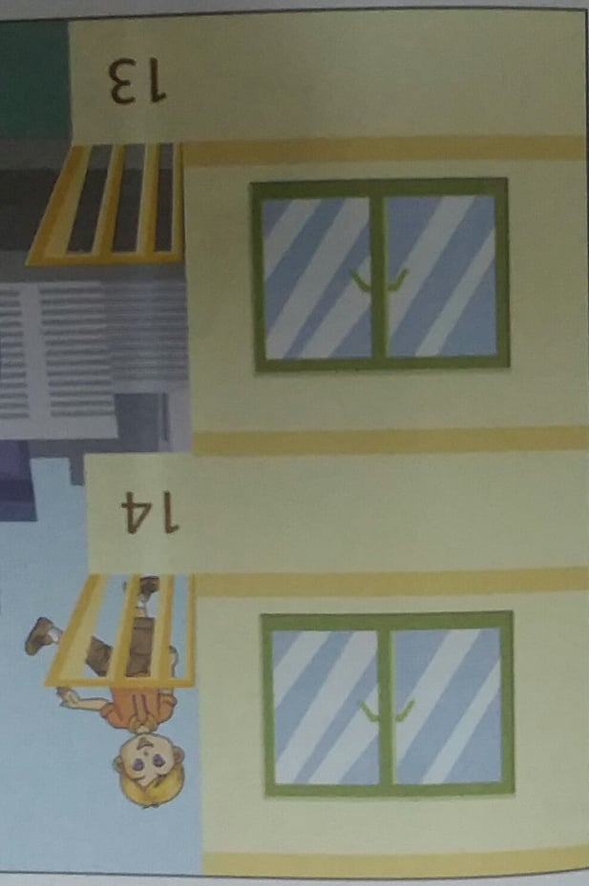
Learn to listen
I live in a flat in a big city. It’s got a balcony and a lift. I live on the fourteeth floor. Bill, my cousin lives in a house in a small village. It’s got two floors and a big garden but it hasn’t got a basement.

Slide 4
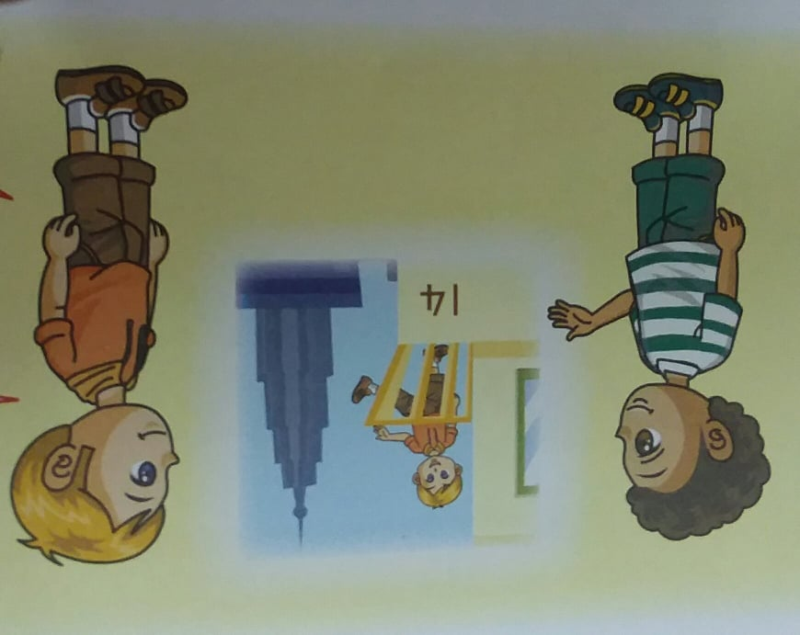
Learn to answer
Has your flat got a balcony?
…………………………
Which floor do you live on?
I live on the………………

Slide 5
Đáp án:
Has your flat got a balcony?
Yes, it has.
Which floor do you live on?
I live on the fourteenth floor.

Slide 6
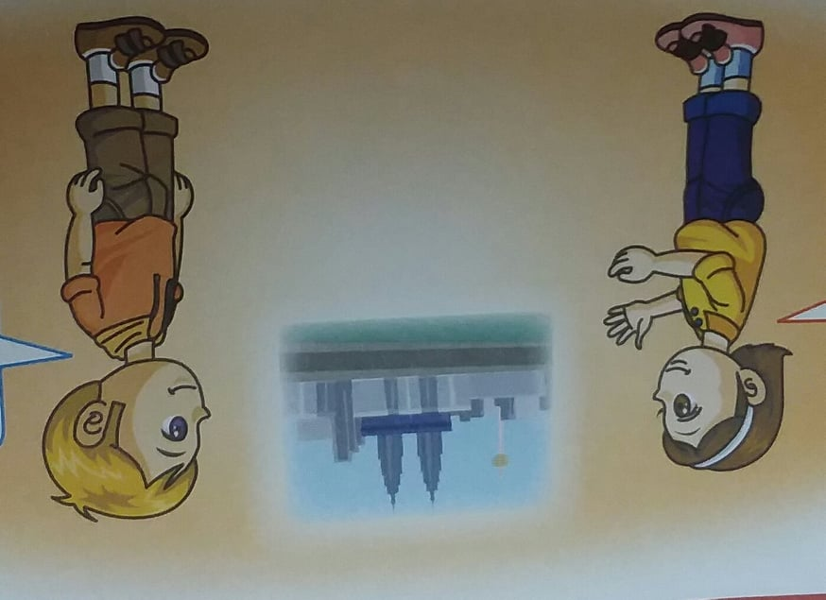
Learn to speak
Because I can see the city from my balcony.
Why do you like living in a flat?

Slide 7
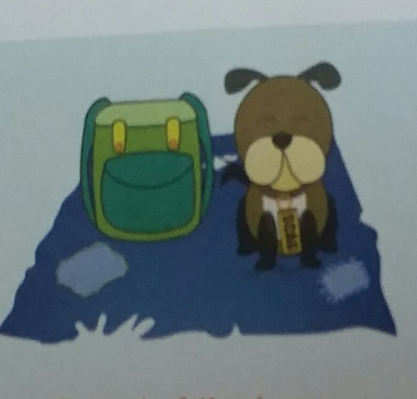
Learn to read
Scag, the dog is on a rag.
The rag is near a bag.
He wears a tag.
His tail wags.

Slide 8
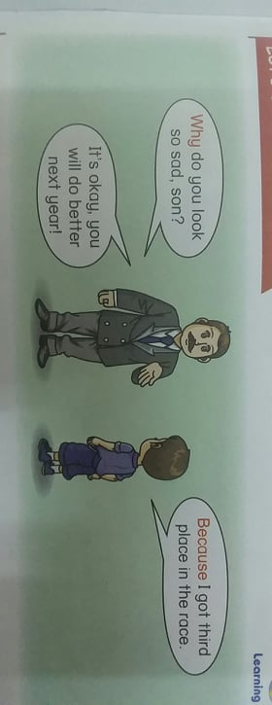
Let’s learn grammar
Because I got third place in the race.
Why do you look so sad, son?
It’s okay, you will do better next year!

Slide 9
Grammar:
We use why when we ask about a reson or a cause. We use because when we explain a reson or a cause.
( Chúng ta dùng Why khi chúng ta muốn hỏi về một lý do hoặc một nguyên nhân. Chúng ta dùng Because khi chúng ta giải thích một lý do hoặc 1 nguyên nhân.)

Slide 10
Make complete sentence with “ why” and “ because”:
A. Why did you eat two burger?
B. Because I was very hungry.
A. Why didn’t you do your homework?
B. Because ……………………….. .
A. Why didn’t you clean the floor?
B. Because ……………………….. .
eat
homework
clean

Slide 11
ĐÁP ÁN:
A. Why did you eat two burger?
B. Because I was very hungry.
A. Why didn’t you do your homework?
B. Because I went to bed early yesterday.
A. Why didn’t you clean the floor?
B. Because I met my friend this evening.
eat
homework
clean

Slide 12
Answer the questions
This is Harry’s Art Drawer.
1) Where are the erasers placed?
In the eighteenth drawer.
Which drawer are the papers in?
………………………….
Where are the pens placed?
…………………………
Where can the scissors be found?
………………………..
No. | Drawer
14 15 16 17 18 19 20 | glue papers colour papers scissors erasers rulers pens

Slide 13
Đáp án:
Where are the erasers placed?
In the eighteenth drawer.
Which drawer are the papers in?
In the fifteenth drawer.
Where are the pens placed?
In the twenty drawer.
Where can the scissors be found?
In the seventeenth drawer.
This is Harry’s Art Drawer.
No. | Drawer
14 15 16 17 18 19 20 | glue papers colour papers scissors erasers rulers pens

Slide 14
GOODBYE

